Slide 1
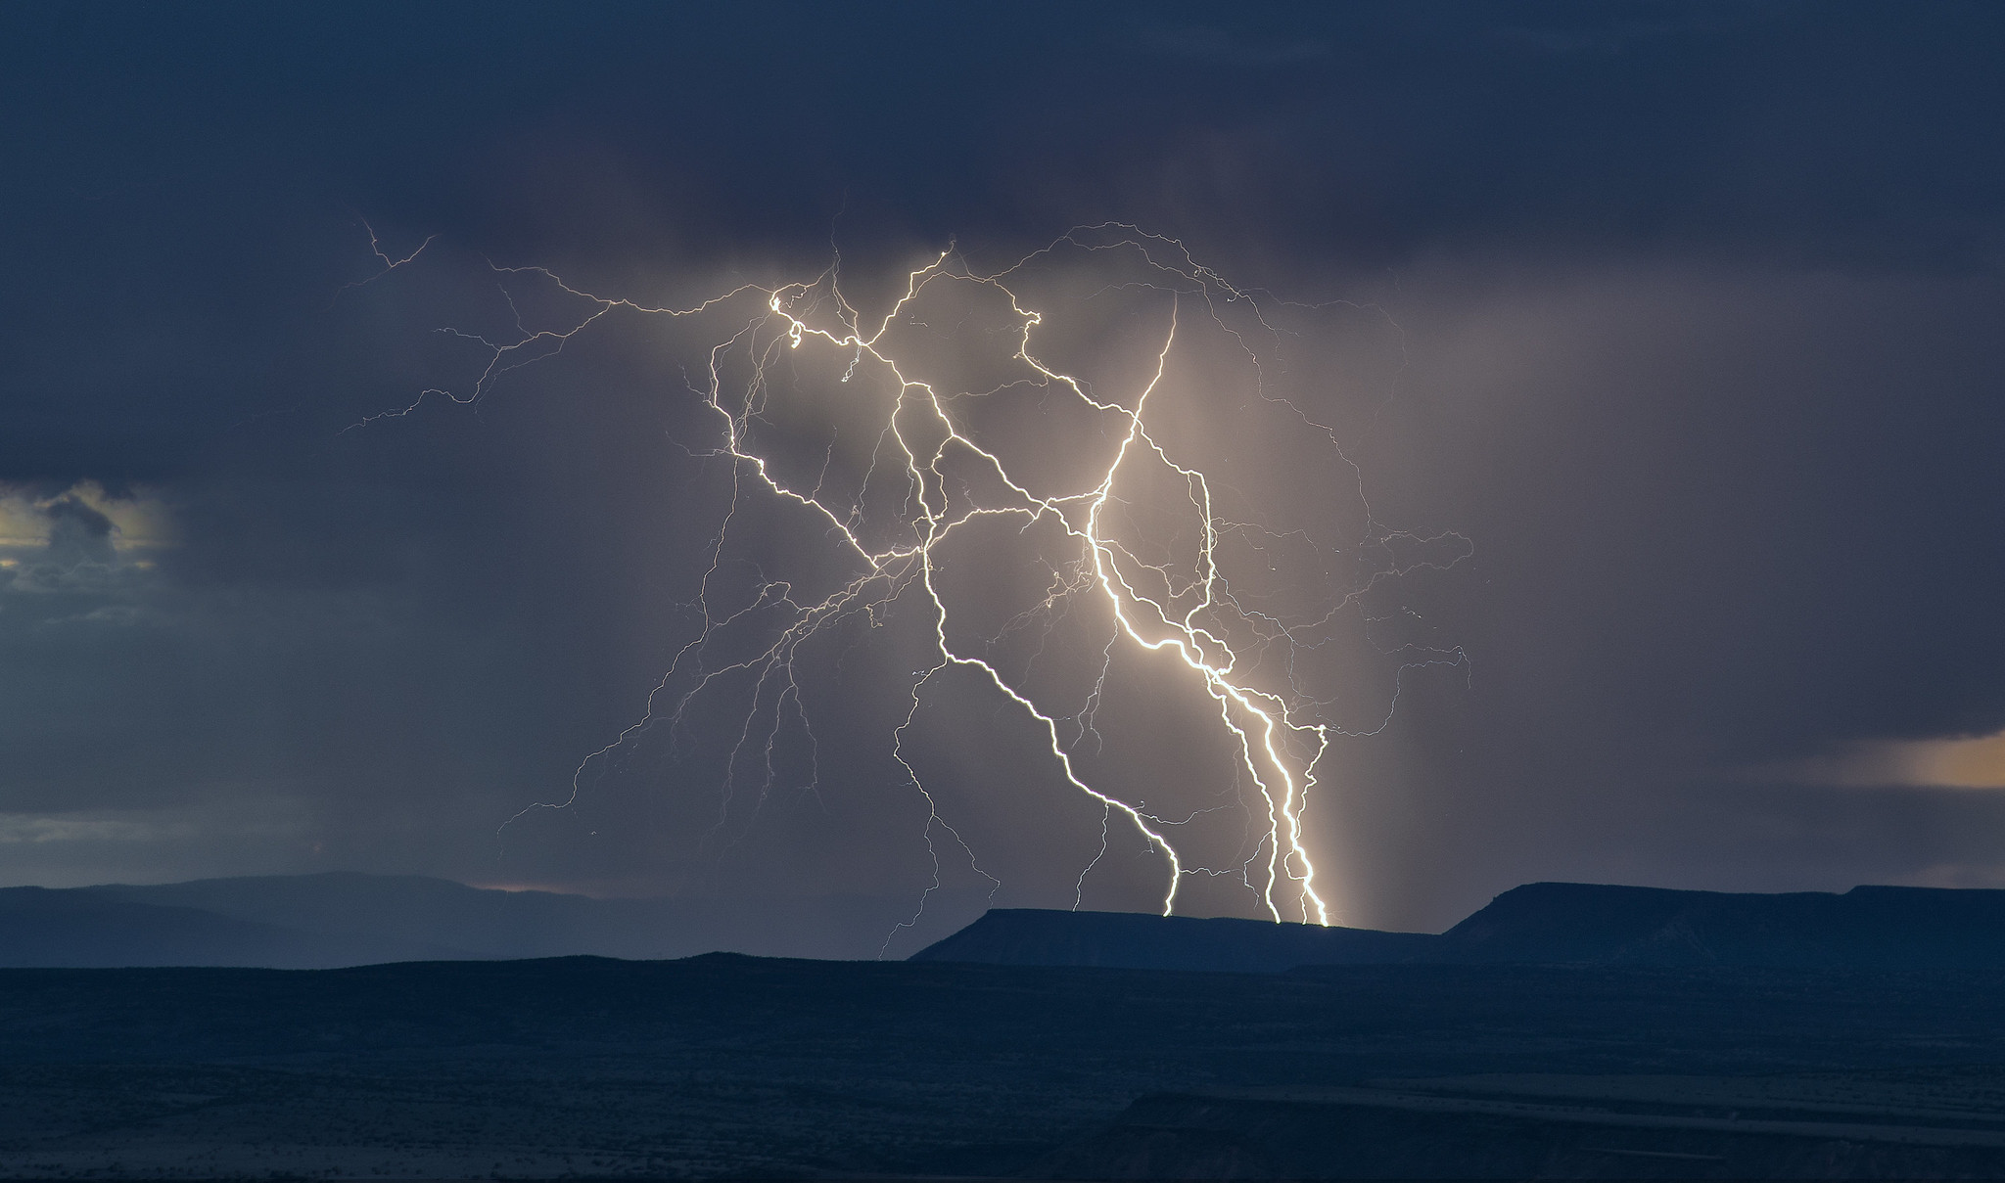
Rewrite Git History to
SUPERCHARGE YOUR CODE REVIEWS
Photo credit: snowpeak on VisualHunt.com

Slide 2
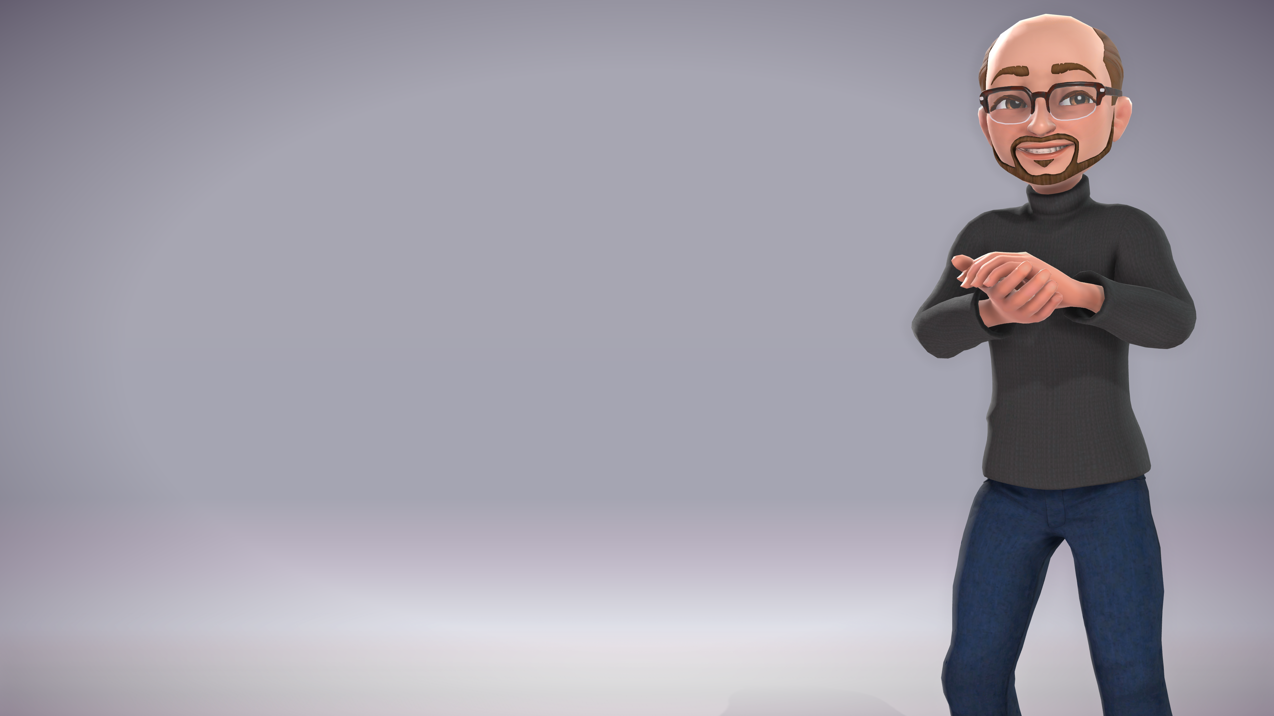

Nate Adams
@psiberknetic
Senior Software Developer – United Fire Group
Agile Enthusiast
psiberknetic@gmail.com
nadams@unitedfiregroup.com

Slide 3
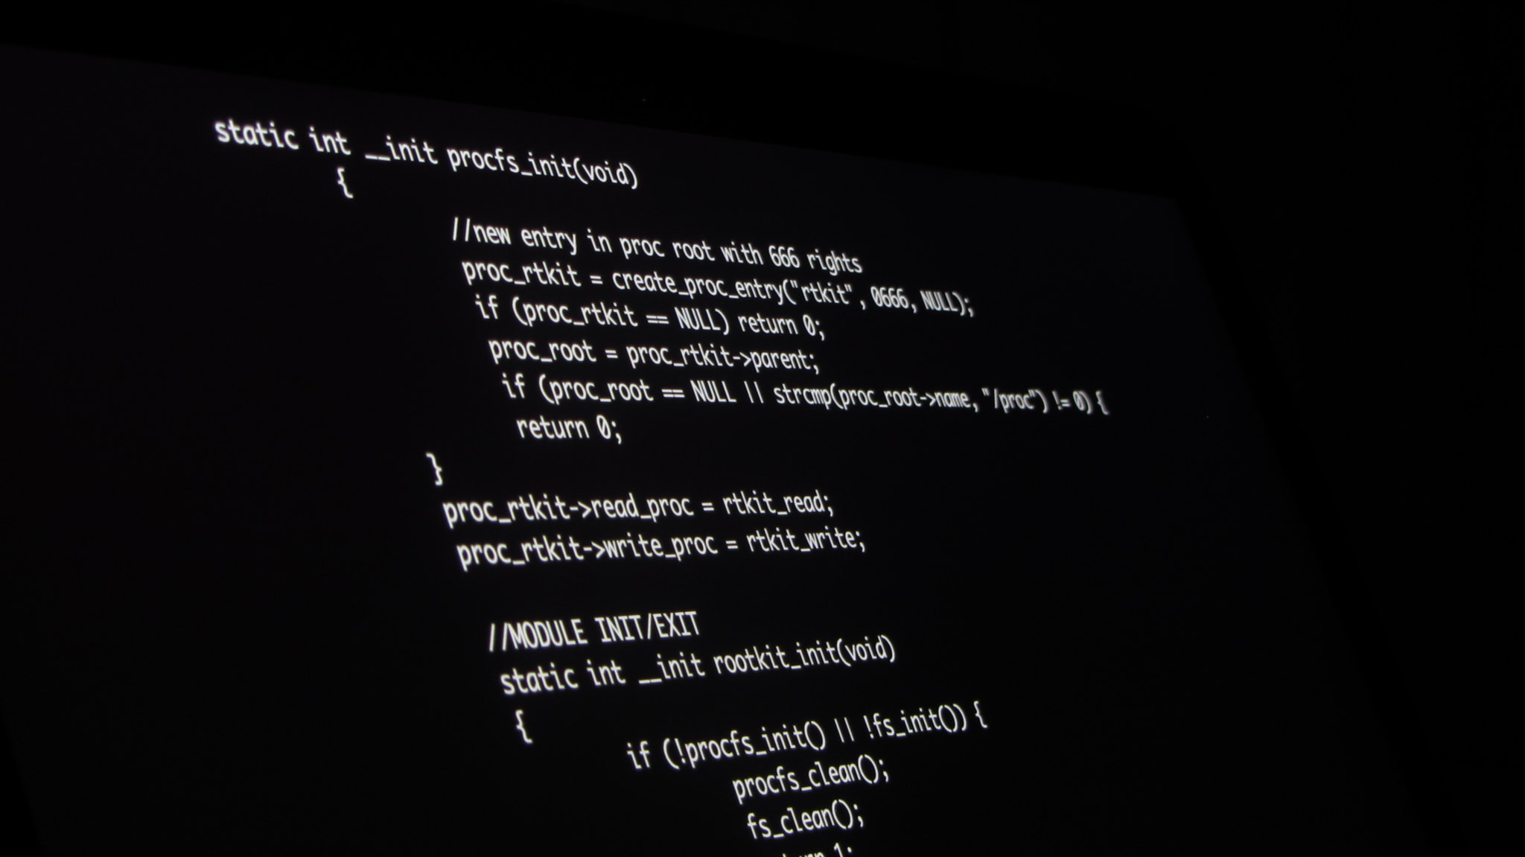
Let’s leave PowerPoint and LOOK AT CODE!

Slide 4
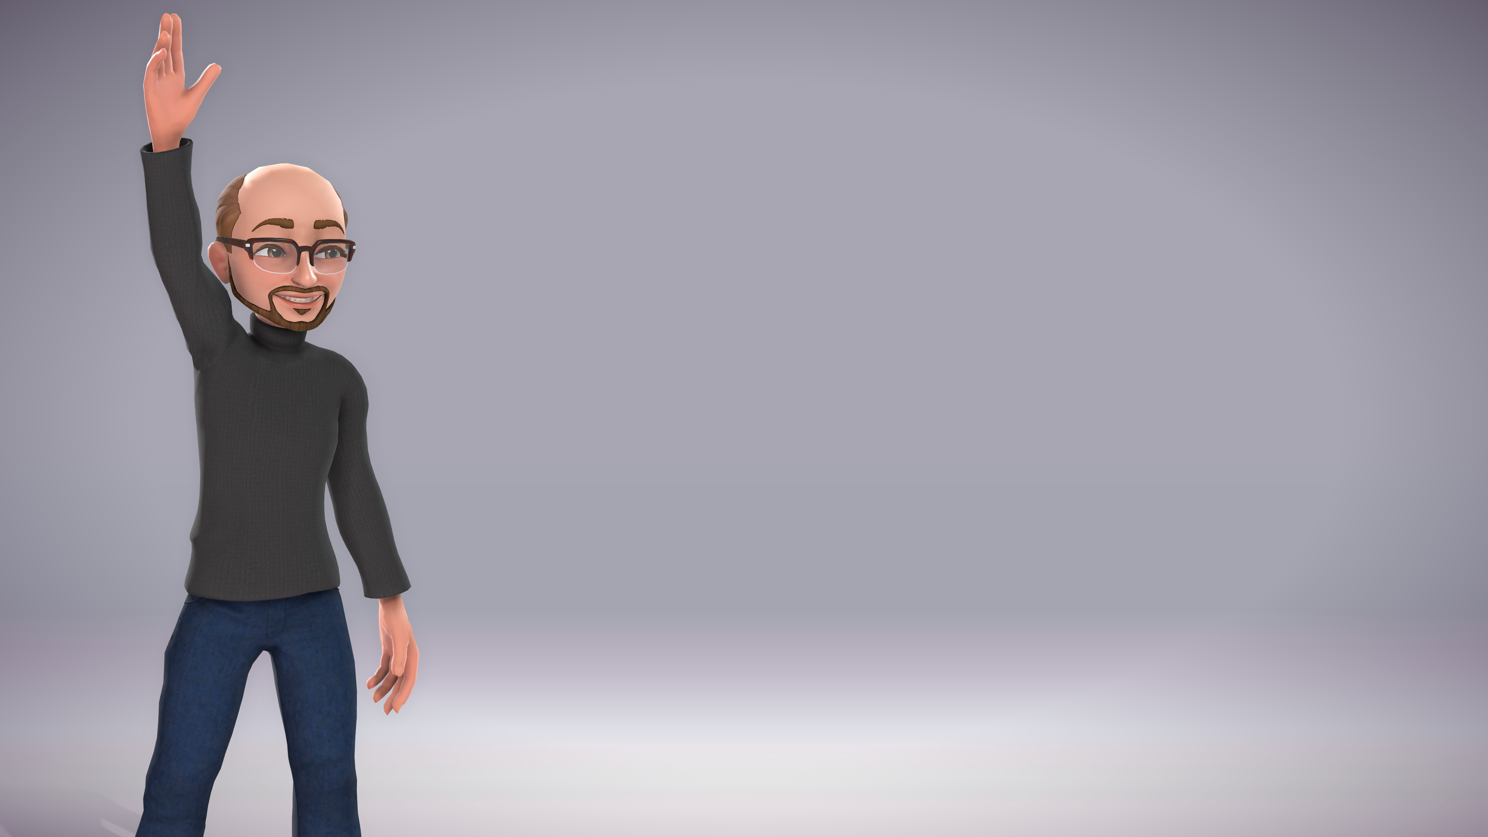
Thanks for coming and hanging out!
Any questions?
Nate Adams
@psiberknetic
Senior Software Developer – United Fire Group
Agile Enthusiast
psiberknetic@gmail.com
nadams@unitedfiregroup.com

